Slide 1
Advanced SQL
queries
PHP web development 2019/2020
Milena Tomova
Vratsa Software
https://vratsasoftware.com/

Slide 2
Table of Contents
Basic SQL quieries
Order By
Limit
Where
Where in
Where Subqueries
Aggregate functions
Sum
Max
Min
Avg
Group By
Distinct

Slide 3
Basic SQL queries

Slide 4
Basic SQL queries
Given table products select all products and order them from the most expensive to less expensive
From the products table – select all product names and prices
Find the product with id = 12. Don’t forget to stop the quierying after the resukt is found!
Find the 5 most expensive products
Find the 3 less caloric products

Slide 5
Agregate functions

Slide 6
Agregate functions
Agregate functions
An aggregate function performs a calculation on a set of values, and returns a single value. Except for COUNT(*), aggregate functions ignore null values.
2. Aggregate functions are often used with the GROUP BY clause of the SELECT statement.

Slide 7
Agregate functions
examples

Slide 8
Agregate functions - examples
COUNT – returns the records in a given table. Often used with a WHERE clause…
SELECT COUNT(*) FROM table_name;

Slide 9
Agregate functions - task
Count the records in the products table
Count the records in the units table
Count the records that are some kind of milk present in the products table
Count the records that are some kind of juice from the products table

Slide 10
GROUP BY statement - examples
GROUP BY – statement,
groups rows that have the same values into summary rows, like "find the number of customers in each country".
SELECT column_name(s) FROM table_name WHERE condition /optional/ GROUP BY column_name(s) ORDER BY column_name(s) /optional/

Slide 11
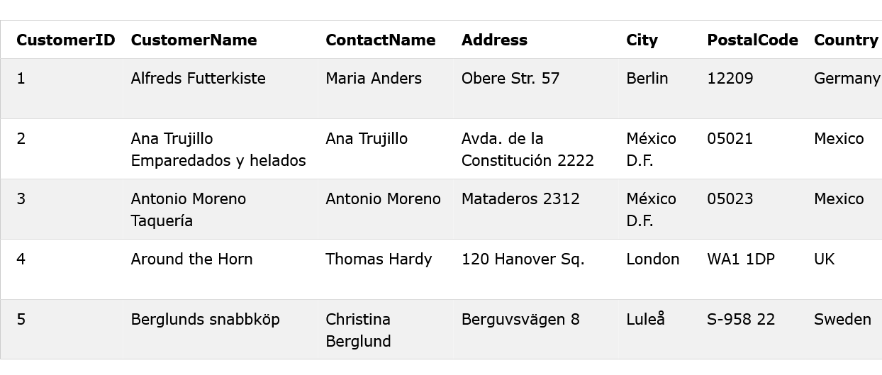
GROUP BY statement - examples
Below is a selection from the "Customers" table in the Northwind sample database:

Slide 12
GROUP BY statement - examples
The following SQL statement lists the number of customers in each country
SELECT COUNT(CustomerID), Country FROM Customers GROUP BY Country;

Slide 13
Agregate functions - examples
AVG – returns the average value of the column in parenthesis
SELECT AVG(column_name) FROM table_name
SELECT AVG(column_name) FROM table_name GROUP BY column_name

Slide 14
Agregate functions - task
AVG
Find the average value of product calories of the products in the database
Find the average value of products` price
Find the average price of the products that are some kind of milk
Find the average calories of the products that have price lower than 10
5. Find the average value of product calories grouping the products by their price
6. Find the average value of product price groping the products by their calories

Slide 15
Agregate functions - examples
MAX – returns the max value of a given table column. Can be combined with a WHERE clause.
SELECT MAX(column_name) FROM table_name

Slide 16
Agregate functions - task
Find the product with the highest calories value
Find the most expensive product
Find the most expensive product with calories value less than 100

Slide 17
Agregate functions - examples
MIN – returns the lowest value of the records in a given table column.
Also can be combined with a WHERE clause.
SELECT MIN(column_name) FROM table_name;

Slide 18
Agregate functions - task
Find the product with the lowest calories value
Find the least expensive product
Find the least expensive product with calories value more than 100

Slide 19
Agregate functions - examples
SUM – returns the sum of the values of the records in a given table column.
Can be used with a WHERE clause
Can be used with a GROUP BY …
SELECT SUM(column_name) FROM table_name

Slide 20
WHERE
in
clause

Slide 21
WHERE IN clause
WHERE IN …
Used to specify multiple possible values for a column to filter result of a SQL query.

Slide 22
WHERE IN …
Find the products that belong to one specific category
SELECT * FROM products
WHERE category_id = 2
Find the products that belong TO MORE THAN ONE specific category
SELECT * FROM products
WHERE category_id IN (2, 3)

Slide 23
Advanced SQL queries

Slide 24
Advanced SQL queries
Find the products that have price higher than the average product price from the records in the products table
Find the products with lower calories value than the average calories of the products in the database

Slide 27



Trainings @ Vratsa Software
Vratsa Software – High-Quality Education, Profession and Jobs
www.vratsasoftware.com
The Nest Coworking
www.nest.bg
Vratsa Software @ Facebook
www.fb.com/VratsaSoftware
Slack Channel
www.vso.slack.com

